Slide 1


PeopleU Sales Funnel Analysis

Slide 2
Contents
Executive Summary
The Funnel Metrics
Background of Project
Funnel Analysis & Drop Off Rate
Methodology
Insight and Recommendation
01
04
02
05
03
06
Company Name

Slide 3


Executive Summary
Project Description:
analyze our customer journey and identify opportunities to improve the performance of our funnel.
Objectives:
Identify funnel bottlenecks and improve conversion from Leads Registered → Deal Won.
Tools:
Data Cleaning and analysis : SQL Bigquery, spreadsheet
Visualization : Tableau, Spreadsheet
Metrics:
Conversion rate/Funnel Metrics
Drop-Off rate
Analysis Result:
Biggest bottleneck : approach - discussion - offer.
CPC are the best value for session source
“Not Answered” : majority reason for drop-off leads.
Recommendation:
Focus on sales team approach - discussion - offer.
Open negotiation after offer sent.
For “Not Answered” Reason, Add more alternative contact method

Slide 4

2. Background of Project
PeopleU is a B2B Software as a Service (SaaS) company that offers a human resource management application. PeopleU has established cooperation with several companies with various scales and industry. PeopleU provides a comprehensive HR management solution with many features.
Currently, the focus of PeopleU is to increase its customer with several initiatives such as evaluating the marketings and acquisition process, also considering offering price packages. Experts, as the person in charge, tries to guide the DA team to provide the proper evaluation and advice regarding how data can be used to provide analysis to support those initiatives.

Slide 5
Business Problem
Objective of analysis
Despite a high number of leads entering the funnel across industries, only 26% of total registered leads convert into Deal Won.This indicates significant drop-off across mid-funnel stages, suggesting inefficiencies in lead qualification, follow-up, or sales execution.
To analyze the end-to-end lead funnel and determine the key stages contributing to low conversion rates. Funnel analysis will be used to quantify drop-offs at each step and guide targeted interventions that can increase the Deal Won conversion.

Slide 6
3. Methodology
01
02
03
04
05
06
Problem Understanding
Data Preparation & Data Cleaning
Exploratory Data Analysis
Data Analysis
Data Visualization
Insight & Recommendation
Understand the conversion rate from the data funnel provided
Conduct the funnel analysis with the metrics that decided on EDA with SQL and excel.
Visualize the analysis into chart, table, and dashboard by using Tableau
Use the result of data analysis to determined the insight and business recommendation to solve the problem
checking double data and null values
Conduct Initial Investigation on dataset to define metrics and test for hypothesis

Slide 7
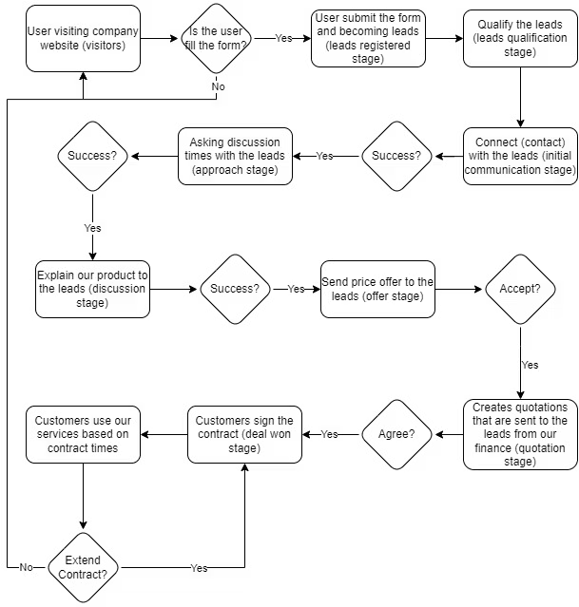
4. The Funnel Metrics
The Business Flow
The Key Metrics
Leads registered
Leads qualification
Initial communication success
Approach success
Discussion success
Offer sent
Quotation received
Deal won
Renewable
Cumulative Conversion Rate
Drop-off Rate

Slide 8
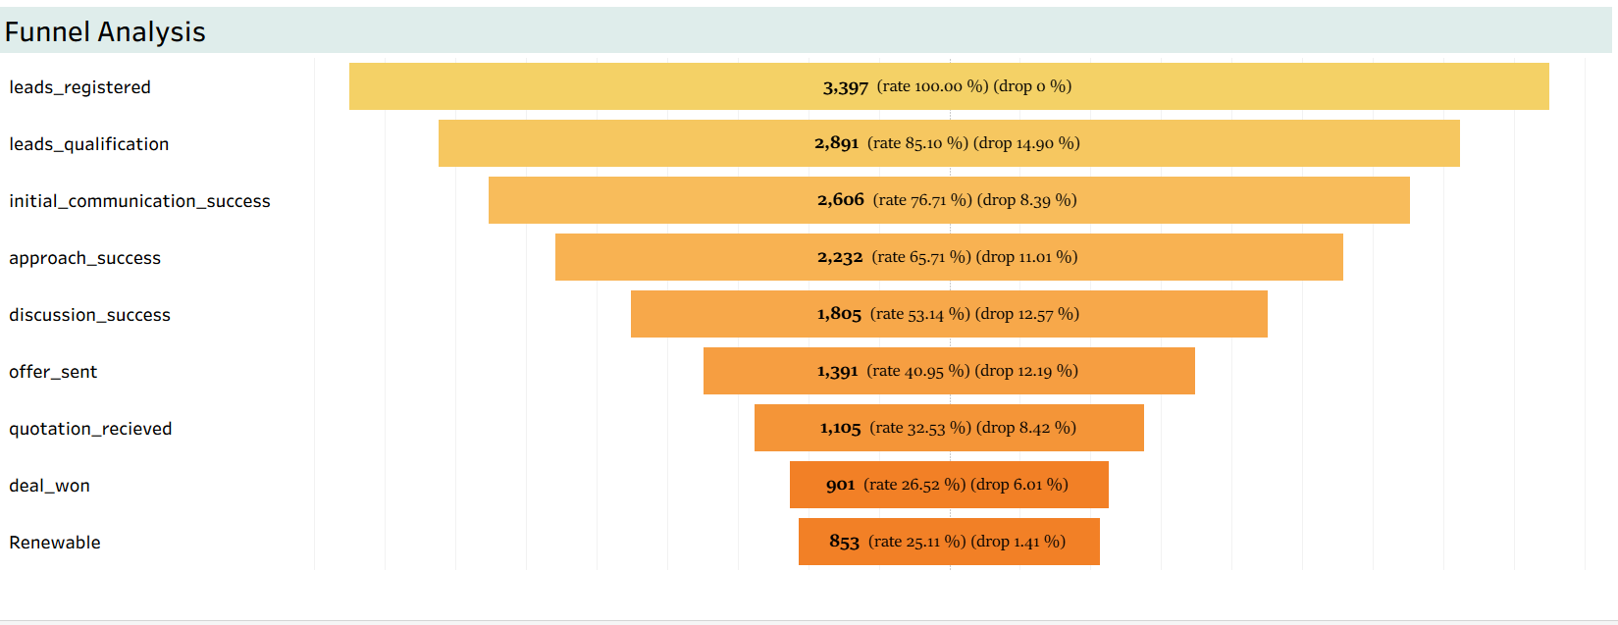
5. The Funnel Analysis
Format : Lead count (cumulative conversion rate) (drop-off rate)
Our funnel starts strong with 3,397 leads, but only 26.52% convert into Deal Won.
The largest drops occur at qualification (14.9%), and 3 stages in the middle : approach - discussion - offer (11-12%).
These mid-funnel weaknesses prevent a significant number of leads from progressing.
By improving these stages, we can dramatically increase our total conversion without needing more leads.

Slide 9
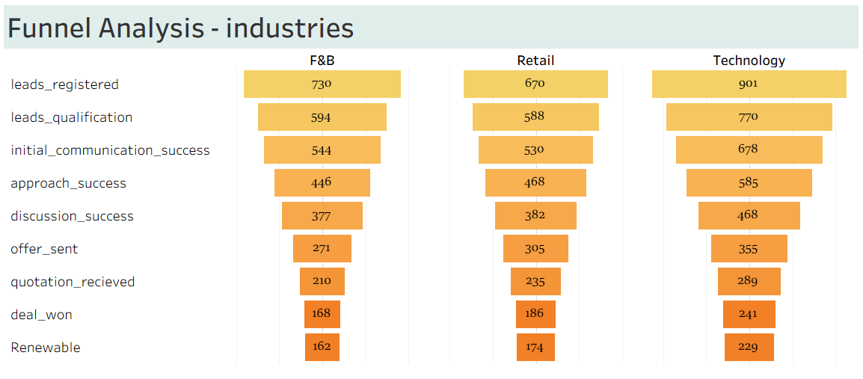
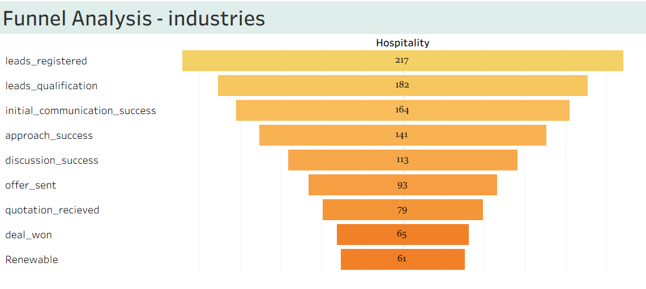
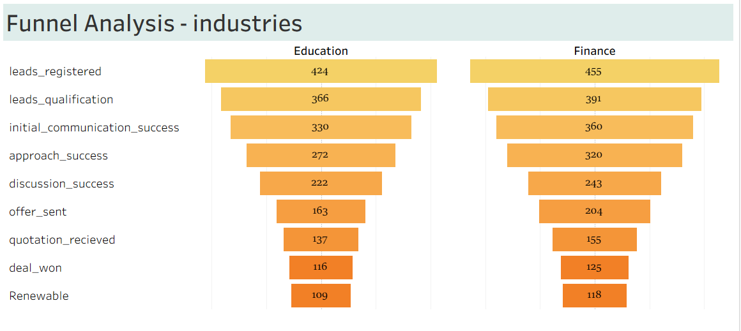
5. The Funnel Analysis - Industries
Summary :
Top leads registered : Technology, F&B, and Retail.
Hospitality is the best-performing funnel overall with best deal conversion (29.95%), but the lowest leads registered count.
Finance & Technology: Large drop in Discussion stage (13–17%)
Insight :
Industry funnels are more similar than different — fixes can be standardized

Slide 10
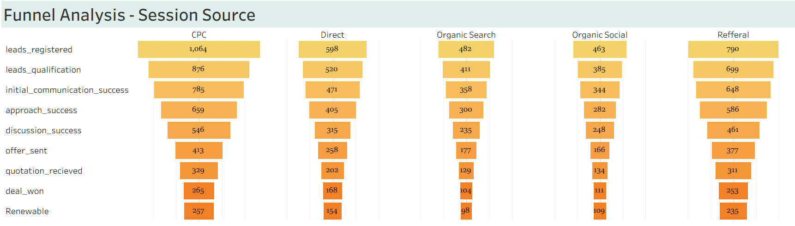
5. The Funnel Analysis - Session Source
 | CPC | direct | Organic Search | Organic Social | Referral
Avg Monthly CAC | Rp 536,719.16 | Rp 1,073,287.72 | Rp 1,209,122.96 | Rp 1,082,536.63 | Rp 1,560,944.58
Summary :
The session-source funnels are more similar than different, indicating that most performance issues stem from internal sales process bottlenecks. This means improvements can be standardized across session source.
Insight :
CPC is currently the most efficient acquisition session source, delivering the highest number of winning deals at the lowest cost.

Slide 11
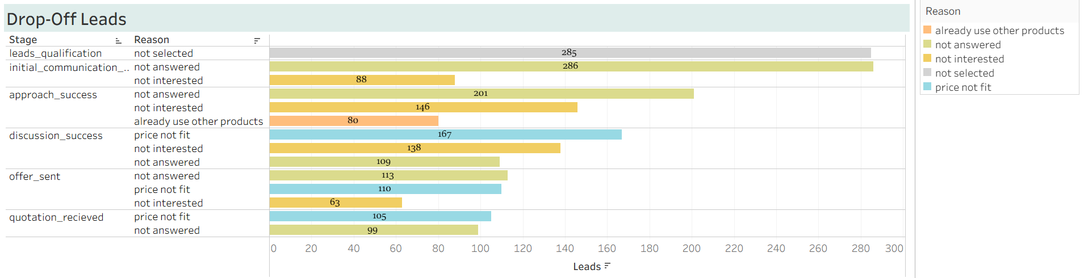
5. Drop-off Rate
Summary :
Majority the reason for drop-off leads in the early stage is “not answered”, while “price not fit” is majority for the rest of stages.
Insight :
“Not answered” is the main reason for drop-off.

Slide 12
6. Insight and Recommendation
Insight
mid-funnel performance is the primary issue
Industry funnels are more similar than different
CPC is currently the most efficient acquisition session source, delivering the highest number of winning deals at the lowest cost.
“Not answered” is the main reason for drop-off, follow up by “Price Not Fit”

Slide 13
6. Insight and Recommendation
Recommendation
Leads Registered : Increase CPC budget and Investigate why Referral is expensive.
Qualification : Strengthen registration validation to improve user qualification
Initial Communication and approach : For “Not Answered” - that majority reason in early clusters, Add more alternative contact method to approach.

Slide 14
6. Insight and Recommendation
Recommendation
Approach - Discussion : Strengthen sales engagement by improving follow-up processes, lead qualification, response time management, and customized proposal methods across industries.
Offer and quotation : Open structured post-offer negotiations to validate price fit and improve deal conversion.

Slide 15
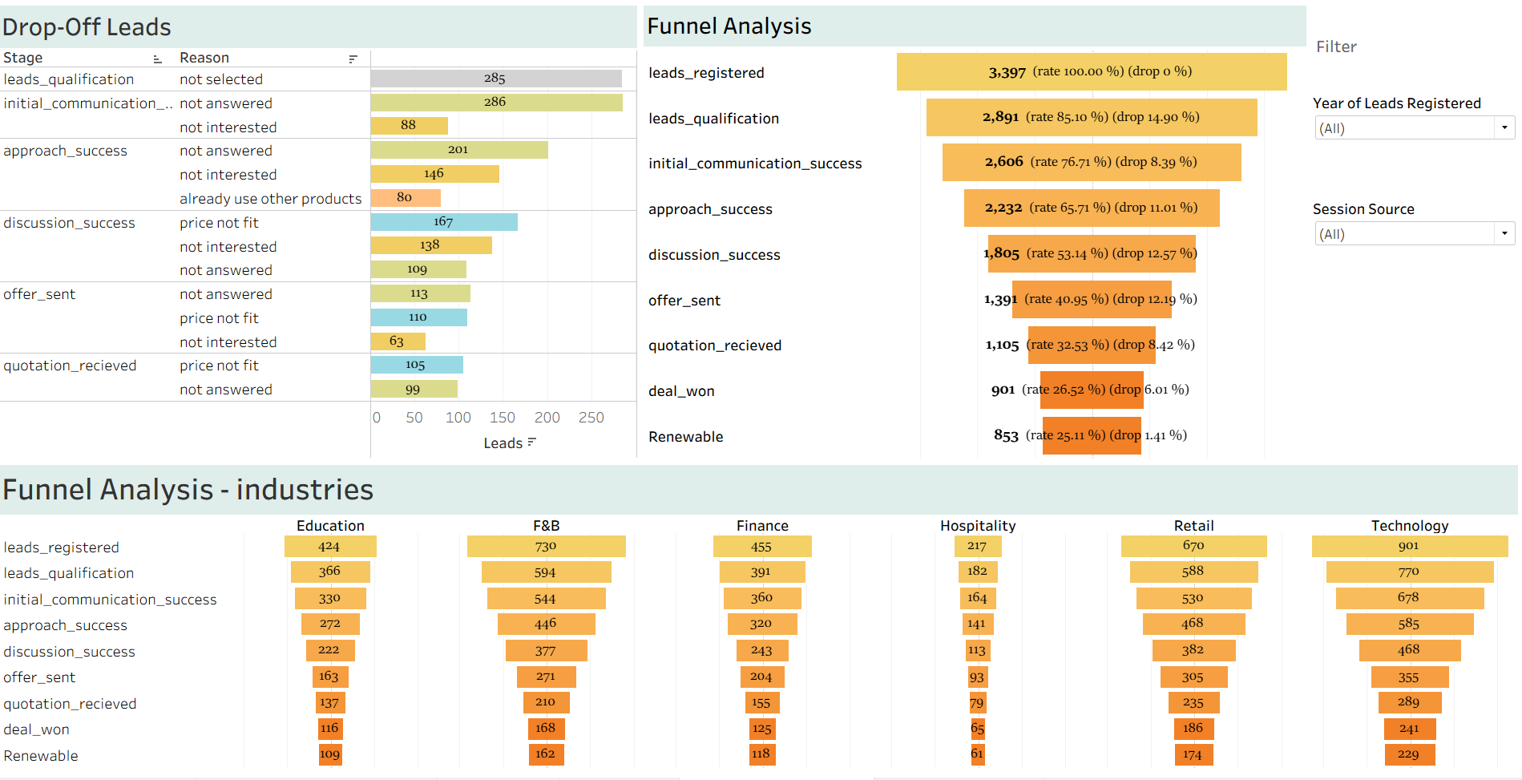
Tableau Dashboard

Slide 16
Appendix - query
SELECT f.funnel_id, f.leads_id,
l.session_source_code, ss.session_source,
l.industry_code, i.industry,
l.leads_registered,
l.number_of_employee,
-- CASE WHEN c.reten_flag = 1 THEN YEAR(c.date) ELSE f.stage_id END stage_id, CASE WHEN c.reten_flag = 1 THEN CONCAT("Renewable ", CAST(YEAR(c.date) AS CHAR)) ELSE s.stage END stage,
CASE WHEN c.reten_flag = 1 THEN 109 ELSE f.stage_id END stage_id, CASE WHEN c.reten_flag = 1 THEN "Renewable" ELSE s.stage END stage,
df.stage_id AS last_stage,
f.timestamp,
f.reason,
c.subscription_type,
c.user_price,
d.user_price_after,
d.discount_type_code,
dt.discount_type,
dt.month_discount,
c.gmv,

Slide 17
Appendix - query
sv.nps,sv.pre_sales_info,sv.sales_knowledge,sv.respon_time,sv.communication
FROM funnel f
INNER JOIN leads l ON f.leads_id = l.leads_id
INNER JOIN stage s ON f.stage_id = s.stage_id
LEFT JOIN contract c ON l.leads_id = c.leads_id AND f.stage_id = 108
LEFT JOIN discounts d ON c.contract_id = d.contract_id
LEFT JOIN discount_type dt ON d.discount_type_code = dt.discount_Type_code
LEFT JOIN sessions_source ss ON l.session_source_code = ss.session_source_code
LEFT JOIN industries i ON l.industry_code = i.industry_code
LEFT JOIN survey sv ON l.leads_id = sv.leads_id
INNER JOIN
( SELECT leads_id, MAX(stage_id) stage_id
FROM ( SELECT leads_id, stage_id
FROM funnel
UNION ALL
SELECT leads_id,109 AS stage_id
-- YEAR(DATE) stage_id
FROM contract
WHERE reten_flag = 1 ) f
GROUP BY leads_id) df ON l.leads_id = df.leads_id
ORDER BY f.leads_id,s.stage_id

Slide 18



Thank You
You can check the tableau public here
Connect to My LinkedIn

